Slide 1




Slide 2
Animals
and
Their Favorite Places

Slide 3
We’re going to learn about different animals’ favorite places.

Slide 4
Every animal has a favorite place.

Slide 5
To help us remember each animal’s favorite place, we’re going to see each animal in their favorite place a few times.

Slide 6
Ready to learn about the animals and their favorite places?

Slide 7
Here come the animals!

Slide 8
Think back to the story about animals and their favorite places.

Slide 9
Today, we’re going to try and match each animal to its favorite place!

Slide 10
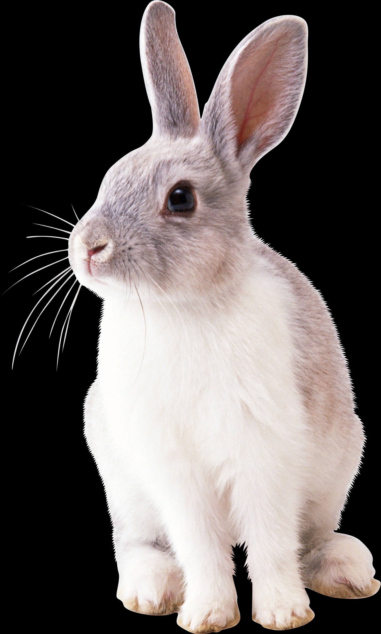

Slide 11
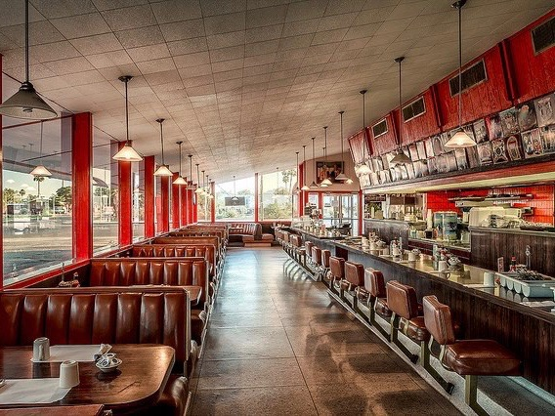
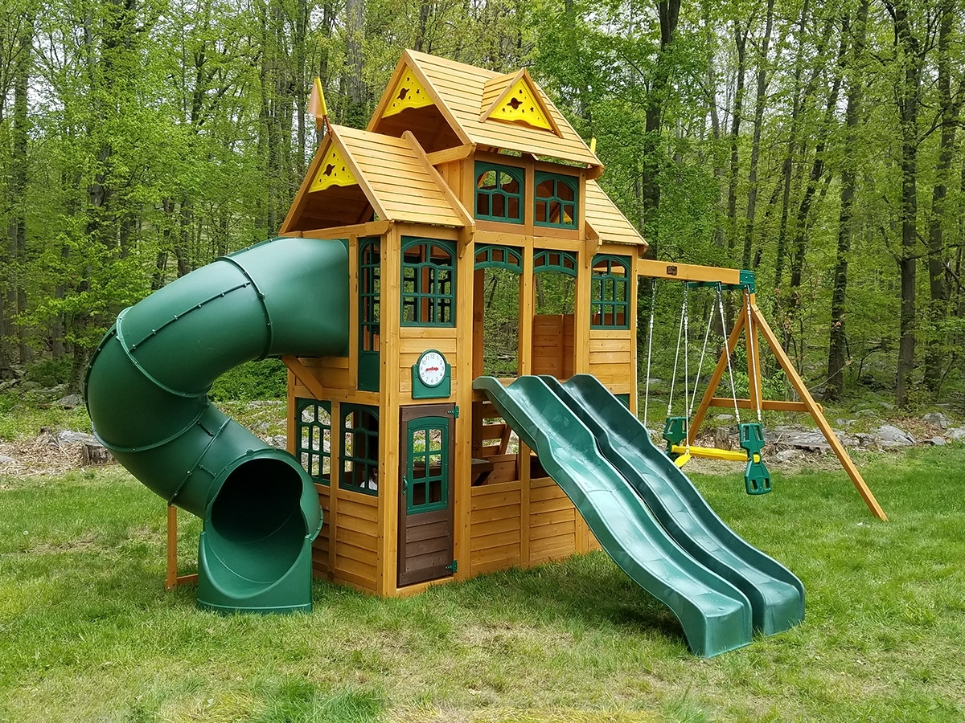
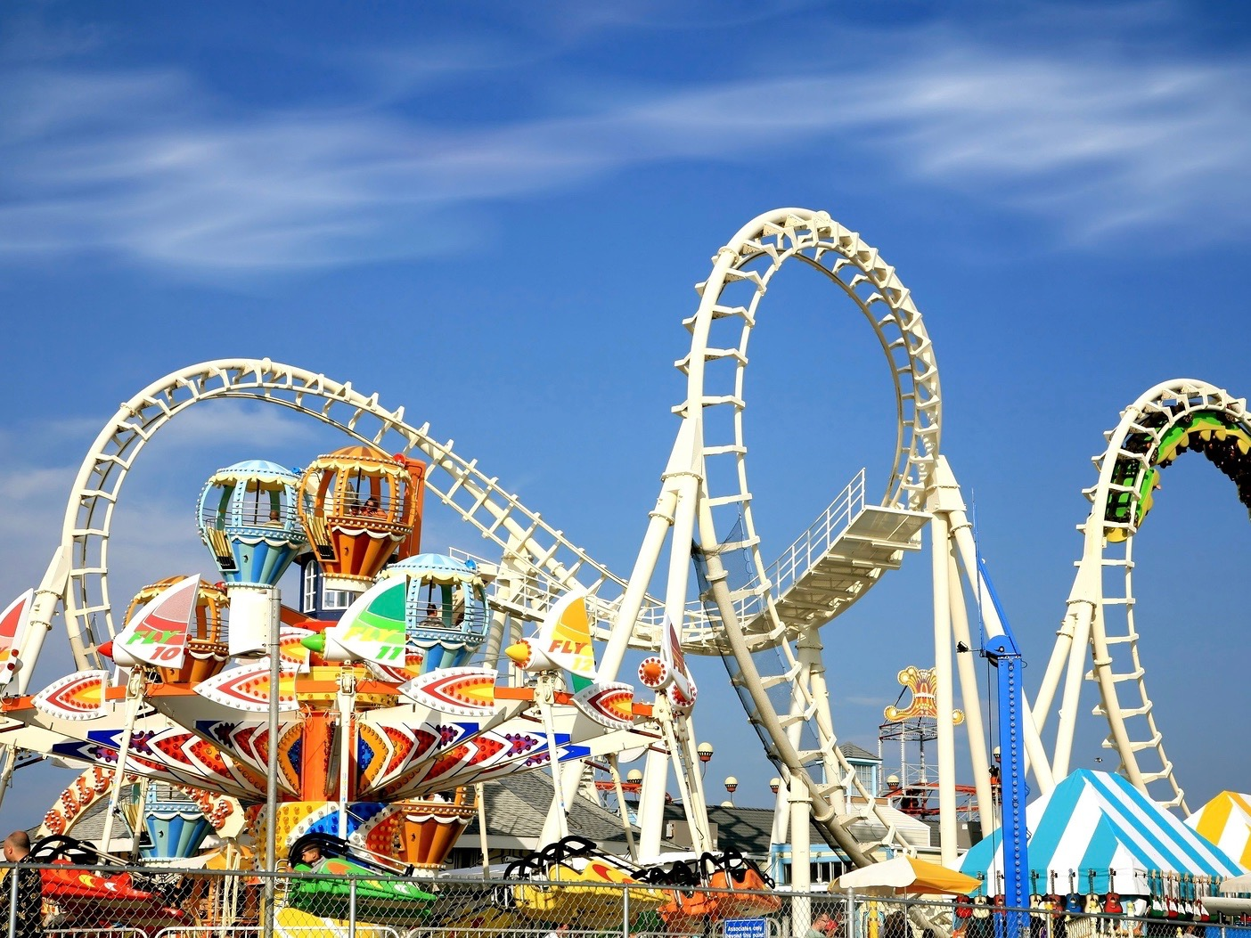
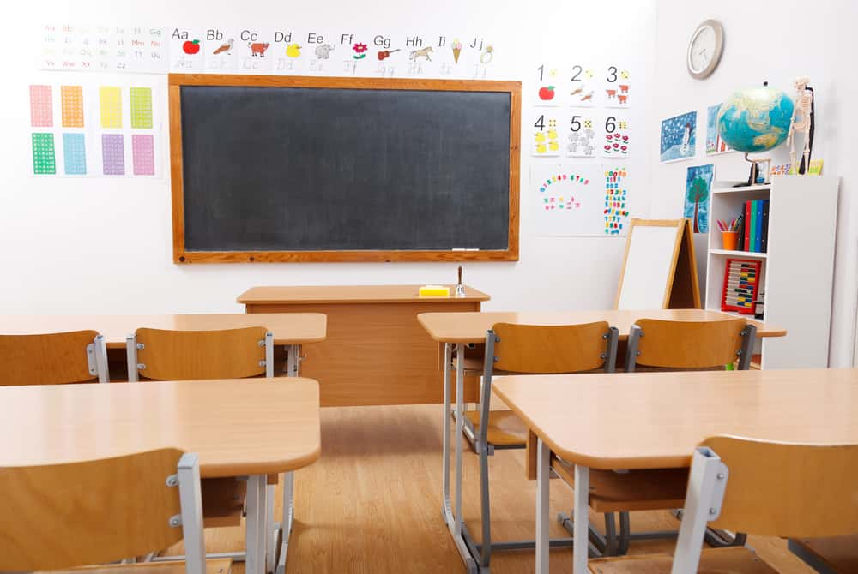

Slide 13
Let’s try this one together!

Slide 14
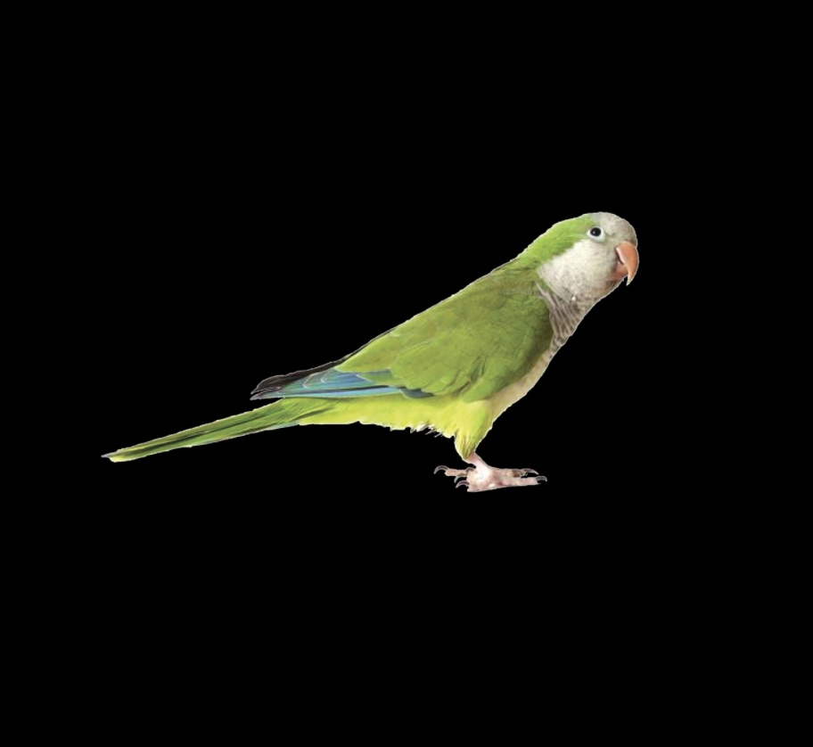

Slide 15
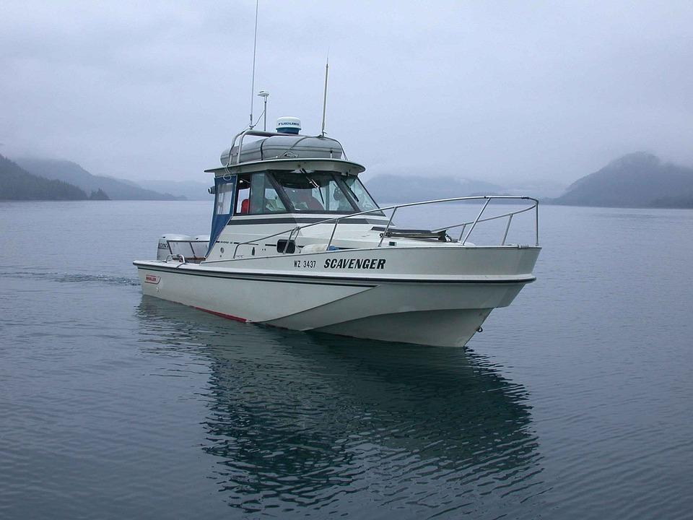

Slide 16
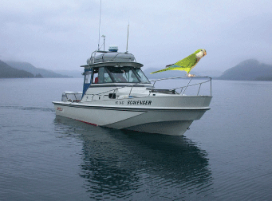

Slide 17
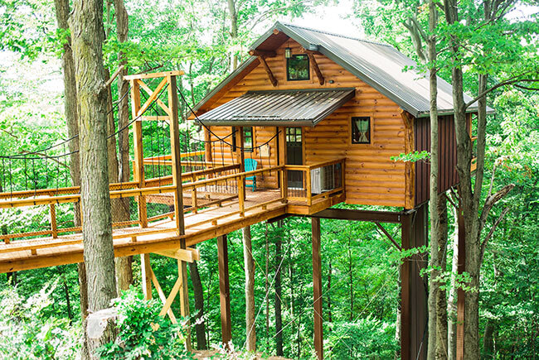
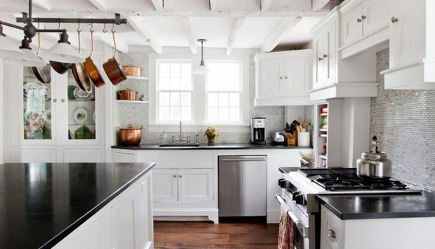
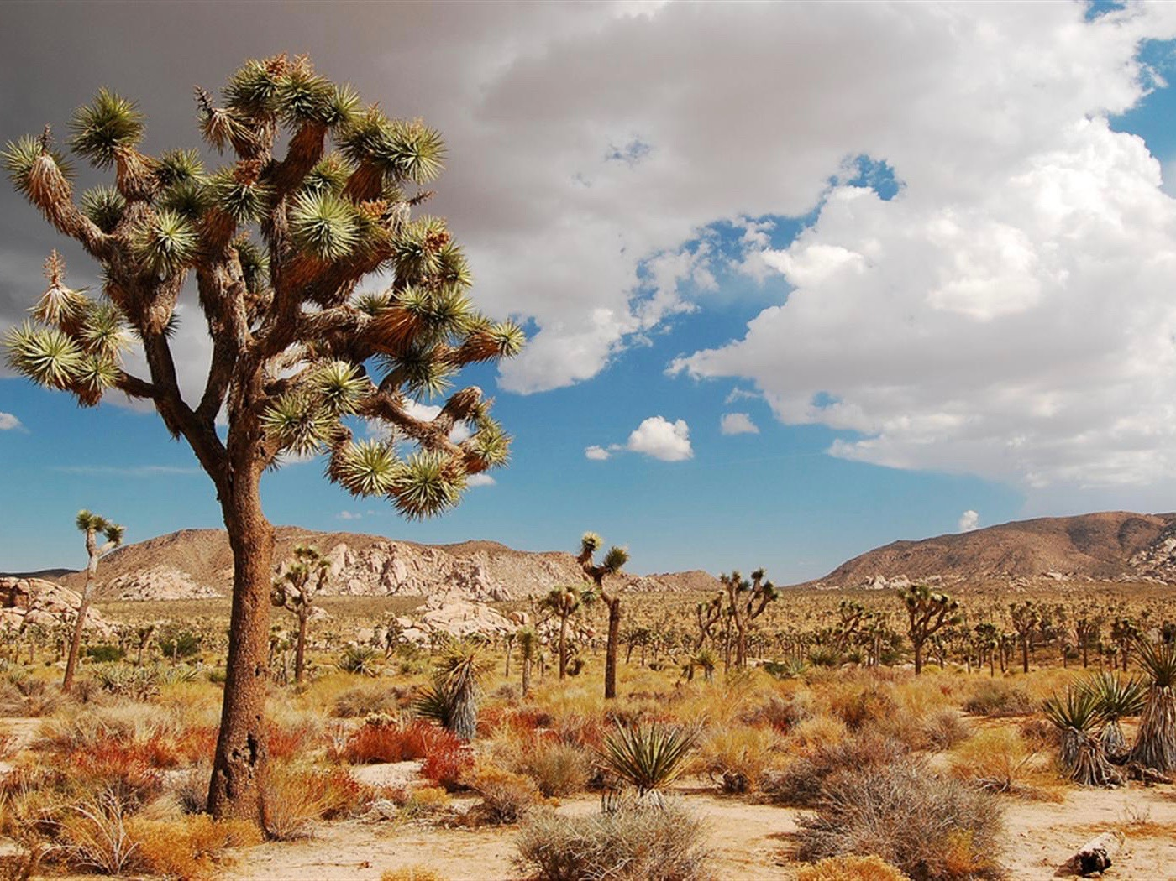

Slide 18
Great job!

Slide 19
Here come more animals and places!

Slide 20
Animals,
Places,
and Things

Slide 21
Today, you will see some pictures of animals, places, and things on the screen.

Slide 22
Ready to see some pictures?

Slide 23
Here come the pictures!

